Slide 1

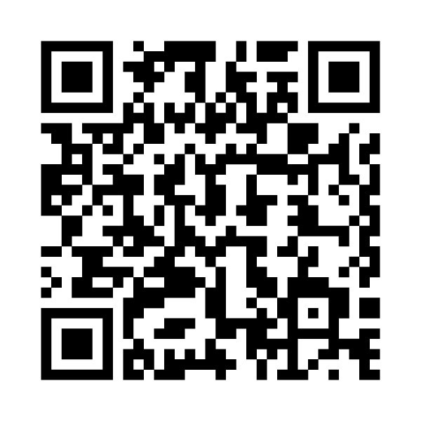

Please Sign In Here

