Slide 1
Notes:
*Introduce self and Shared Hope International*
Hi! My name is XXX and I am a trained volunteer Ambassador of Hope at Shared Hope International. Shared Hope International is a non-profit organization working to keep youth safe from predators. After our session today you will be safer because you learn what to do and how to have fun online without being exposed to things that might be harmful.
Shared Hope takes a three-pronged approach:
1. Preventing the conditions that foster sex trafficking 2.Restoring and empowering survivors 3. Bringing justice to vulnerable youth
We also believe the fight for justice starts by preventing trafficking and educating our community, which leads me to the reason I was invited here today, our Internet Safety Initiative.

Slide 2
Your Name
Volunteer Ambassador of Hope
Notes:
How many of you have had other discussions about internet safety? (raise hands) That’s good! We all need to know what’s out there and how to navigate safely just like when you start driving a car.
Studies all over the US have told us that the average age of a person victimized by online toxic, abusive relationships is between 14 and 16 years old. So we can talk about things today that will keep you safe into your teen years.
Many people don’t even realize the internet has dangers like these, so today I’m going to pull back the curtain and show you some of their tricks so you’ll be able to stop predators and protect your friends.

Slide 3
Staying Safe in the Digital Age
Notes:
The internet is an amazing tool that allows you to learn things, meet people and go places around the world that you might never visit in person. And that is exciting!
I know you’re smart, you’re responsible and you want to use the internet as a good citizen. And that’s why I’m here today – so you can be the same awesome responsible person online!
So let’s get started.

Slide 4
The Problem
•We trust the internet too much. But is the person with the puppy emoji who they say they are?
•Predators look for kids who will trust them and create relationships by just talking to each other
•Traffickers want to
•Gain your trust
•Separate you from other friends
•Meet up with you
Notes:
Before predators can trick you into meeting with them, they have to find a way to start a conversation. That most often starts online in social media, gaming or music apps.
First they watch your profile and interactions long enough to get to know you.
Then they pretend to be just like you. You like dogs? They will make a profile with a puppy emoji! You are going out for soccer? They will say they play soccer too!
They want you to trust them and feel like they are your friend.
Before we jump in today, we want to make clear: We are very aware that since you all have the distinct advantage of growing up in the digital age, you may be better at identifying fake profiles and predatory behavior than the average parent of teacher might assume. In fact, if you have any sort of social media profile, its probable that you’ve already rejected the advances of strangers who might have been a predator before. And for that, we want to applaud you!
We know that you probably already know things like identifying a fake profile by the fact that it only has one clear picture and no followers; or that the mysterious person who popped up in your direct messages, asking a you and a bunch of strangers if you want to date them is likely not a real person.
In this presentation, our goal is that we will all
→better understand and identify a predators’ tactics to try to trick you
→be equipped with knowledge about technology dangers, such as what pictures to never send or receive
→have clear “how-to” safety tips about what to do if you or someone you know is being exploited.
OUR GOAL IS to shine light on the online world where predators are using our vulnerabilities to gain our trust and exploit us, so ultimately, you are empowered to protect yourself, and sex trafficking is stopped before it ever has the chance to begin.

Slide 5
Natural “Vulnerabilities"
Want love and acceptance
Hope we fit in
Can feel misunderstood,
insecure, and lonely
Notes:
We know that we are not all the same. Just look around the room! But our brains and the way we are all wired is pretty much the same and that will help us better understand the tactics of a predator.
It is a fact that as a human being, we all want to be loved and accepted. We want it from our family, our friends, those we interact with regularly, and, to a point, even from chance encounters.
Now, say you are one of those magical people who doesn’t care how many followers you have on social media or what the popular kids think of you. That is fantastic! But unfortunately, even you are not immune. For instance, you still care about what your best friend thinks of you; or at your favorite musical artist ( even if you never get the chance to meet them). If nothing else, we all have that thing that keeps us up at night when the server said “enjoy your meal,” and you are embarrassed that you enthusiastically replied “you too!”
We all need to feel we are a part of a greater community — preferably one that is encouraging, accepting, and empowering of our hopes and dreams. If we don’t have a community readily available to us, chances are we will seek one out. Again, this doesn’t have to be the whole school or greater society—this can simply be the people you play video games or sports with, people you sit with at lunch and hang out with on the weekend, people you go to church or play music with—whatever your “tribe” looks like.
As a natural extension of our social and emotional development, we are also inclined to feel misunderstood at times. Even if we are often surrounded by people and activity, we can feel dismissed, insecure, and lonely. These feelings are particularly strong during teenage years. (Sorry—its true! It’s the chemicals in our brains that are helping us grow up!)
We will explore some of this later in this presentation, so we can see how predators understand these common, human thoughts and feelings, and make it their business to discover a young person’s hopes, dreams and hurts in an effort to trick them. The process is called Grooming. That means they are doing one thing in order to accomplish another thing. They want you to get used to them so they can move into your life and change your thinking.

Slide 6
The Grooming Process
They take their time
They seem like a friend
They develop trust
They share and keep secrets
They separate you from others
They will try to control you
Notes:
There are people online who want to get to know you and are not looking out for your best interests. They know how to follow you online and they also know how to appear to be someone you might want to get to know a little better.
They will listen to you and make you feel really special. They will tell you how smart, good-looking, funny you are. And how much they like being with you.
They ask you if you can tell there is something special just between the two of you.
Do you feel misunderstood and lonely? They are the only one who understands you and they are always just a text away from making you smile.
Can you see how they are playing on your desire to fit in, to feel loved and accepted?
They may begin to tell you how special you are, and they want to be with you all the time.
It makes you feel special, so you start pushing away your other friends in order to be with them.
Separating you from your friends and family so you begin to feel like you ‘belong’ to them?
Before long, they may ask you to send a picture of yourself. And they may send you a picture of a really fun looking kid your age. Then they may ask you for a ‘special’ picture just for them. Maybe in your PJs, or in your swimsuit. We’re going to talk more about the tactics they may use with the goal of meeting up with you.
1) Grooming can take place quickly like just a week, or it can happen over an extended period of time — sometimes months, or even years.
Most predators won’t feel threatening or demanding in your first conversations online. They will appear innocent, fun and friendly, but almost involve some level of deception. Sometimes they never reveal their real age, even after forming a relationship. Like the fact that they’re really a 24 year old man, not a cute guy or girl your own age.
2) Predators work hard to appear familiar.
It’s not hard for them to follow your online posts, to find out lots of personal information about you. They know how to extract and keep this information for use at a later time. They will look up your social media or app profiles and can find out where you live (generally or specifically), where you like to hang out, what you like to do, and who you hang out with. From there, a predator can easily make up a profile that would seem harmless, even familiar to the person they want to approach—the type of person that you might feel even belongs in your “tribe”.
You know how you follow a particular person because you hope to learn more about them, and think about how you can become a part of their friend circle. You notice all the details about them until you feel like you really know them. It’s a funny and embarrassing part of modern social interactions but REMEMBER, we aren’t the only ones who know how to extract this information from social media.
3) Predators use personal information to develop a sense of trust — a bond — between themselves and a person they want to control.
They will play on the your normal and natural human needs, showering a person with compliments and encouraging emotional dependency while preying on their insecurities and emotions. They may even offer to buy gifts for them off their Amazon wish list or buy them skins or loot boxes on Fortnite or APEX.
They will sell lies and try to “sweep their victim off their feet,” sometimes even flattering them with fake promises about meeting in person or running away together. Remember when we talked about how predators use the way our brains are wired to groom potential victims?
4) They will establish secrecy as another tactic to gain the confidence of their target and to step into the role of being their “best friend.”
Because of that, victims can become dependent on their relationship with the predator, a relationship that often turns romantic. This dependence allows the predator to control the other person’s behavior as the online grooming process progresses. They can even learn what kind of clothes you wear, how you speak, how you feel about your life, and what your hurts, hopes and dreams are. This how they establish a special bond with their victim.
They ask you to share your secrets with them. They tell you that you can always trust them. They may tell you that you’re too mature for your other friends in your school; or you’re too smart to have a curfew/ why would your parents treat you like a little kid? I know you better than anyone else. I’m the only one who really cares what you think and how you feel. Do you see it? They want you to trust only them.
Another way traffickers establish secrecy is by having a shared secret with the victim, such as the relationship itself. This will help emotionally bond the two together, as well as isolating the youth from any potential feedback from friends or family about this inappropriate, controlling relationship.
5) The process continues until the sharing involves something you don’t want anyone else to know you’ve done, possibly sending photos you know you shouldn’t have, or something that the predator will use against you to threaten you if you don’t do what they want.
Predators will use secret conversations and things you’ve shared to create a climate of shame and a sense of dependence on them that can become a dangerous controlling relationship where you are afraid to tell anyone, but it’s also kind of exciting and makes you feel special or grown up to be doing this all by yourself. Let’s stop a moment and just be sure you all know this: You can always get help no matter what you’ve done! Especially if someone is controlling you and telling you not to tell.
6) At some point, they will try to force you to meet with them. They may threaten you like, “do as I say, or I’ll text your pictures to your parents or post them on your social media so your followers can see what you did.” Don’t ever feel trapped like you can’t get out. REMEMBER, YOU CAN ALWAYS GO FOR HELP TO A TRUSTED SAFE ADULT.

Slide 7
Never send a picture you wouldn’t want everyone to see.
Notes:
So why are we talking about sending pictures of yourself that you don’t want anyone else to see? Whether or not you would send pictures, research shows that 1 in 4 teenagers admit to sending compromising pictures.
In our experience fighting against those who would try to trick you and control you, sending pictures like this can be dangerous and is absolutely not worth the risk. While you may feel comfortable and safe in that moment, how often have we been wrong about our first impressions of someone? Even the people we trust the most have the potential to get into a fight and your feelings for them change! They may feel we treated them wrongly and act out in anger.
It’s devastating and life-changing to get in trouble with the law for having or sending pictures of minors with few or no clothes. If you never send a picture you wouldn’t want everyone to see - Maybe you have a special someone and you want to send them a private picture of yourself. STOP AND THINK about the relationship you thought would be forever…and it lasted 2 months
Maybe you think ‘everyone is doing it’ How can this be harmful?
Those special pictures can be saved by them and even shared with others—and if they are mad at you they may post it for everyone to see. And that can be devastating. Imagine how you would feel if you had trusted them with that photo, and now they are posting it to your classmates, your church friends or even your family?
Texting a picture with few or no clothes on is called sexting. We just talked about good reasons not to do it, but on tope of that: It’s against the law to send or have pictures of a minor and you can be held accountable. Some of these things could ruin your life forever.

Slide 8
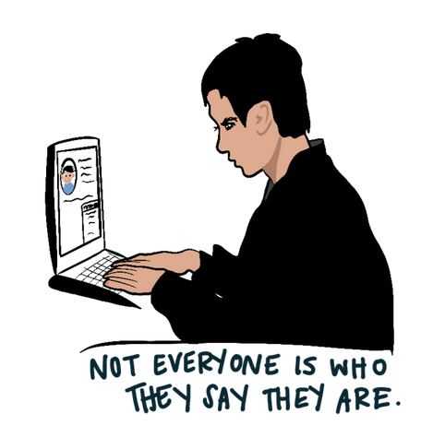
STAYING SAFE
Don’t share your address, where you live or go to school, or the places you regularly frequent. Your friends know where you live and to school, and anyone who doesn’t know you in real life shouldn’t have that information.
Guard your feelings, fears, hopes and dreams. If you’re having a really bad day with mom, talk to your best friend or your trusted adult and vent it there. The whole world isn’t a safe place for your emotions.
Always assume that there might be people watching your social media, gaming or other app communications and be on guard for any interaction from someone you don’t know.
Notes:
Just read through these without comment. Let them absorb the information

Slide 9
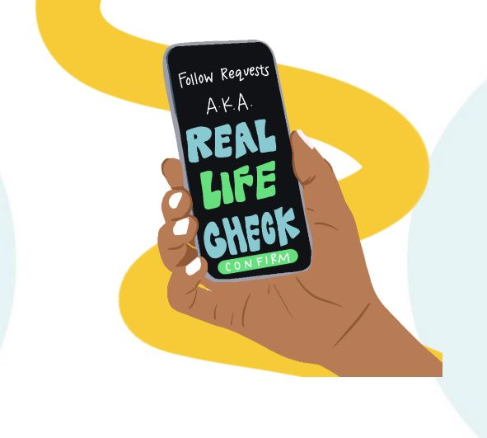
DON’T EVEN TALK
If someone tries to talk to you online and you don’t know them.. DELETE.
Don’t even start a conversation. If you don’t know them in real life, don’t talk to them on the internet.
Even if they say they are a friend of your friend’s friend.
Notes:
Just read through these without comment. Let them absorb the information

Slide 10
TRUST YOUR INSTINCTS
Does something feel weird?
Does it seem off?
If you’ve already started a conversation. STOP and WALK AWAY.
Don’t delete the conversation. Take screenshots and
Share with a trusted adult and ask for their help.
If the person talking to you is possibly a predator, ask the adult to report it to cybertipline.org Cybertipline is part of the National Center for Missing and Exploited Children. They will tell you what to do.
Notes:
If you recognize any of these signs in someone you are speaking with online, take the following steps immediately:
Stop talking with them and block them. Period. There is no need to explain. You don’t owe them anything. Your safety should come before any societal niceties.
Save and take screenshots of your conversations with them. If your intuition is correct, they are probably dangerous and will try to twist the situation. Even if you are ashamed of the content of the conversation or feel like whatever happened was your fault—which it wasn’t—you never know when you might need receipts of these conversations.
Report them to the app. If they are talking with you, they might be talking with other young people who might not be as knowledgeable about online sex trafficking as you are. The app needs to know so they can investigate.
Report them to the National Center for Missing and Exploited Children (NCMEC) CyberTipline.org Not only will the experts at NCMEC be able connect you with resources to help you heal, they will also advocate for your tip to law enforcement. This could not only lead to justice for you, but it could actually help save the lives of the other people the trafficker is manipulating!

Slide 11
HOW TO PROTECT OTHERS
• If they become overly obsessed with online activity
• If they withdraw from family or friends
• If they hide their screen when you get near them
• If they get unreasonably upset when they can’t be online
• If they receive phone calls or gifts from someone that no one else knows
Notes:
WARNING SIGNS YOU CAN WATCH FOR:
If they become obsessed about online activity: predators may become angry and threatening them if they aren’t always available for online communications.
If they withdraw from family or friends: predators will try to isolate their victim from loved ones in order to control them.
If they hide their screen when you get near them: predators often make their victims promise to keep their relationship a secret due to its inappropriate and manipulative nature.
If they receive phone calls or gifts from someone that no one else knows: predators will give a victim love and attention as a way to build trust during the grooming process, sometimes via virtual or physical gift-giving.

Slide 12
HOW TO KNOW IF YOUR FRIEND
MAY BE IN TROUBLE
• Sexting or sending/receiving compromising photos
• Unexplained absence from school; truancy
• Sudden change in dress or style
• Overly tired or falling asleep in inappropriate settings
• Withdrawn, depressed, or distracted
• Bragging about making or having lots of money
• Displays expensive clothes, accessories, or shoes
Notes:
*Feel free to simply list these. They are good to know as general signs of trafficking for a friend who’s watching if their friend is in trouble.
BE A NOSY FRIEND!!! Talk to your friend if you’re concerned about them. Ask questions. Try to get them to a safe adult to get help if they’re in danger. If they won’t listen, YOU GO TO A TRUSTED ADULT and tell them what’s happening.
You may save their life.

Slide 13
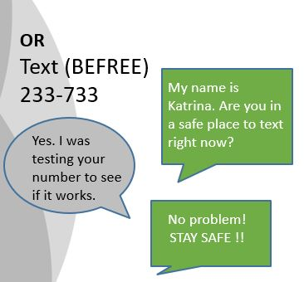
CALL 1-800-THE-LOST 1-800-843-5678 National Center for Missing & Exploited Children
Or Cybertipline.org
You don’t have to know everything, just tell us what you know.
Notes:
If you are victim of being threatened because of pictures you wish you hadn’t sent, or being forced to do things you don’t want to do, or you think someone you know might be a victim of revenge porn, sextortion, or being controlled please reach out to a trusted adult and your local law enforcement or call the National Center for Missing & Exploited Children for help at 1-800-THE-LOST or 1-800-843-5678.
I have asked your teacher ahead of time and they have given you permission to take your phones and put this number in your cell phone. You never know when you will recognize the signs of predators trying to control you or a friend, and making this call could save their life!
*Wait for them to be finished… but also know they might be taking a little extra time to text if you give them too much of a window ☺*

Slide 14
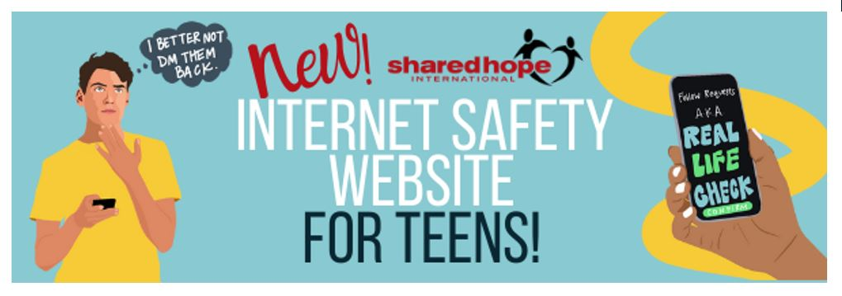
Questions?
Youthonline.sharedhope.org
Notes:
Time for questions.

